Slide 1
Chapter 11
How to validate data

Slide 2
Objectives (part 1)
Applied
Given the data validation requirements for a web form, use any of the validation techniques presented in this chapter to implement that validation.
Knowledge
Describe the default data validation provided by model binding.
Describe the use of attributes for data validation.
List six data validation attributes.
Describe the use of tag helpers for data validation.
Describe the use of the IsValid property of a controller’s ModelState property.
Describe the use of CSS to format validation messages.

Slide 3
Objectives (part 2)
Describe the use of a controller’s ModelState property for checking the validation state of a control and setting a custom error message.
Describe the use of model-level and property-level validation messages.
Describe the use of unobtrusive client-side data validation.
Distinguish between client-side validation and server-side validation.
Describe the process of customizing server-side data validation.
Describe the process of implementing remote validation.
Describe the process of customizing client-side data validation.

Slide 4
The Movie class
public class Movie
{
public string Name { get; set; }
public int Rating { get; set; }
}

Slide 5
A strongly-typed view that posts a Movie object to an action method
@model Movie
...
<div asp-validation-summary="All" class="text-danger">
</div>
<form asp-action="Add" method="post" class="form-inline">
<div class="form-group">
<label>Name:</label>&nbsp;
<input asp-for="Name" class="form-control" />
</div>&nbsp;
<div class="form-group">
<label>Rating (1 - 5):</label>&nbsp;
<input type="text" asp-for="Rating"
class="form-control" />
</div>&nbsp;
<button type="submit" class="btn btn-primary">Submit
</button>
</form>
...

Slide 6
An action method that receives a Movie object from the view
[HttpPost]
public IActionResult Add(Movie movie)
{
if (ModelState.IsValid) {
/* code to add movie goes here */
return RedirectToAction("List", "Movie");
}
else {
return View(movie);
}
}

Slide 7
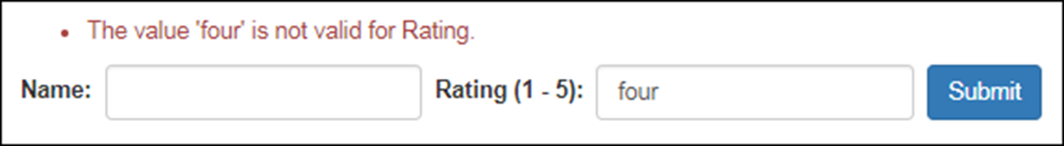
How it looks in the browser when the rating can’t be cast to an int

Slide 8
Common data attributes for validation
Required
Range(min, max)
Range(type, min, max)
StringLength(length)
RegularExpression(ex)
Compare(other)
Display(Name = "n")

Slide 9
The Movie entity class with data attributes
using System.ComponentModel.DataAnnotations;
...
public class Movie
{
[Required]
[StringLength(30)]
public string Name { get; set; }
[Range(1, 5)]
public int Rating { get; set; }
}

Slide 10
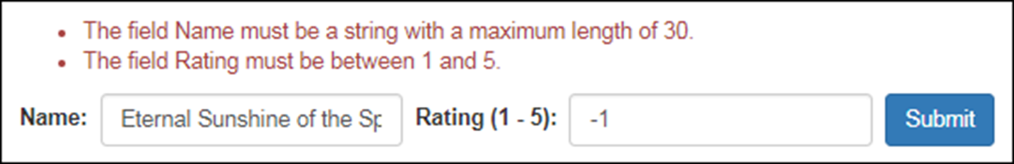
The view after the user submits invalid data

Slide 11
The default validation messages
Attribute Message
Required The field [Name] is required.
Range The field [Name] must be between [minimum] and [maximum].
StringLength The field [Name] must be a string with a maximum length of [length].
RegularExpression The field [Name] must match the regular expression '[pattern]'.
Compare '[Name]' and '[OtherName]' do not match.

Slide 12
How to replace the default message with a custom message
[Required(ErrorMessage = "Please enter a name")]
[StringLength(30,
ErrorMessage = "Name must be 30 characters or less.")]
public string Name { get; set; }
[Range(1, 5,
ErrorMessage = "Please enter a rating between 1 and 5.")]
public int Rating { get; set; }

Slide 13
The Customer class
public class Customer {
[Required(ErrorMessage = "Please enter a name.")]
[RegularExpression("^[a-zA-Z0-9]+$",
ErrorMessage = "Name may not contain special characters.")]
public string Name { get; set; }
[Required(ErrorMessage = "Please enter a date of birth.")]
[Range(typeof(DateTime), "1/1/1900", "12/31/9999",
ErrorMessage = "Date of birth must be after 1/1/1900.")]
public DateTime? DOB { get; set; }
[Required(ErrorMessage = "Please enter a password.")]
[StringLength(25)]
[Compare("ConfirmPassword")]
public string Password { get; set; }
[Required(ErrorMessage = "Please confirm your password.")]
[Display(Name = "Confirm Password")]
public string ConfirmPassword { get; set; }
}

Slide 14
A validation tag in a strongly-typed view that posts a Customer object
<div asp-validation-summary="All" class="text-danger">
</div>
...
<input asp-for="Name" class="form-control" />
<input type="text" asp-for="DOB" class="form-control" />
<input type="password" asp-for="Password"
class="form-control" />
<input type="password" asp-for="ConfirmPassword"
class="form-control" />

Slide 15
An action method that receives a Customer object from the view
public IActionResult Index(Customer customer) {
if (ModelState.IsValid) {
// code that adds customer to database
return RedirectToAction("Welcome");
} else {
return View(customer);
}
}

Slide 16
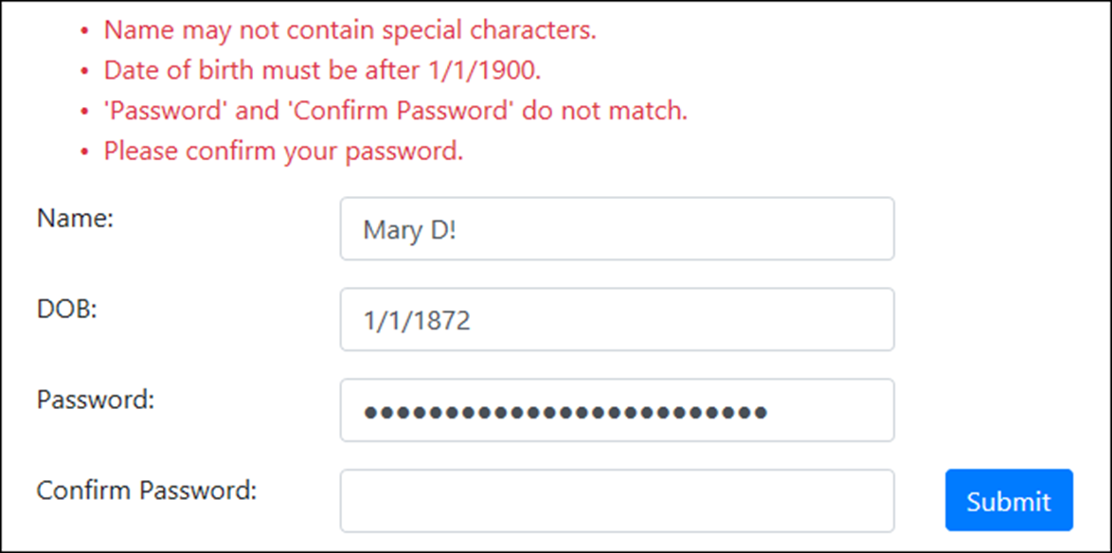
The Registration page after the user submits invalid data

Slide 17
The HTML emitted for an <input> tag bound to the Name property
<input type="text" class="form-control"
data-val="true"
data-val-regex="Name may not contain special characters."
data-val-regex-pattern="^[a-zA-Z0-9 ]&#x2B;$"
data-val-required="Please enter a name."
id="Name" name="Name" value="" />
The HTML emitted for that <input> tag when data validation fails
<input type="text" class="form-control input-validation-error"
data-val="true"
data-val-regex="Name may not contain special characters."
data-val-regex-pattern="^[a-zA-Z0-9 ]&#x2B;$"
data-val-required="Please enter a name."
id="Name" name="Name" value="" />

Slide 18
The HTML emitted for a summary of valid data
<div class="text-danger validation-summary-valid"
data-valmsg-summary="true">
<ul><li style="display:none"></li></ul>
</div>
The HTML emitted for a summary of invalid data
<div class="text-danger validation-summary-errors"
data-valmsg-summary="true">
<ul>
<li>Please enter a name.</li>
<li>Please enter a date of birth.</li>
</ul>
</div>

Slide 19
Some CSS styles in the site.css file
.input-validation-error {
border: 2px solid #dc3545; /* same red as text-danger */
background-color: #faebd7; /* antique white */
}
.validation-summary-valid { display: none; }
.validation-summary-errors ul { list-style: none; }

Slide 20
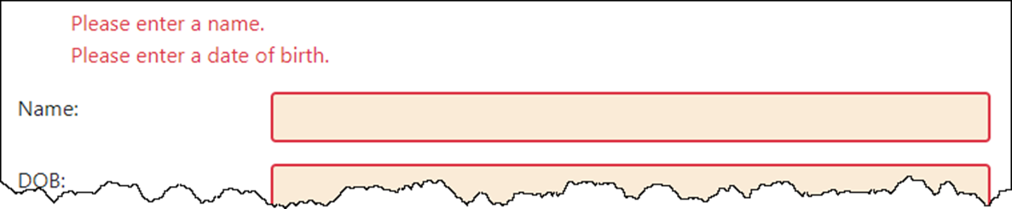
The view with formatted validation

Slide 21
Properties of the ModelStateDictionary class
Count
ErrorCount
IsValid
Keys
Values
Methods of the ModelStateDictionary class
AddModelError(key, msg)
GetValidationState(key)

Slide 22
Code that adds a validation message to the ModelState property
using Microsoft.AspNetCore.Mvc.ModelBinding;
...
[HttpPost]
public IActionResult Index(Customer customer)
{
string key = nameof(Customer.DOB);
if (ModelState.GetValidationState(key) ==
ModelValidationState.Valid) {
if (customer.DOB > DateTime.Today) {
ModelState.AddModelError(
key, "Date of birth must not be a future date.");
}
}
if (ModelState.IsValid) {
// code that adds customer to database
return RedirectToAction("Welcome");
}
else {
return View(customer);
}
}

Slide 23
Two tag helpers used with data validation
asp-validation-summary
asp-validation-for
The values of the ValidateSummary enum
All
ModelOnly
None

Slide 24
An action method that adds a model-level validation message
[HttpPost]
public IActionResult Index(Customer customer) {
if (ModelState.IsValid) {
// code that adds customer to database
return RedirectToAction("Welcome");
} else {
ModelState.AddModelError("",
"There are errors in the form.");
return View(customer);
}
}

Slide 25
Part of a view that displays both model-level and property-level messages
<div asp-validation-summary="ModelOnly"
class="text-danger"></div>
<form asp-action="Index" method="post">
<div class="form-group row">
<div class="col-sm-2"><label>Name:</label></div>
<div class="col-sm-4">
<input asp-for="Name" class="form-control" />
</div>
<div class="col-sm-6">
<span asp-validation-for="Name"
class="text-danger"></span>
</div>
</div>
...

Slide 26
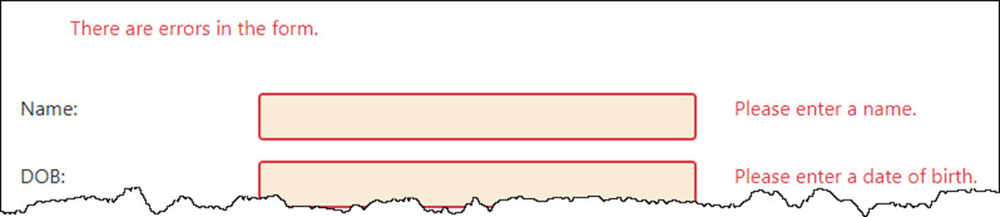
The form in the browser after validation fails

Slide 27
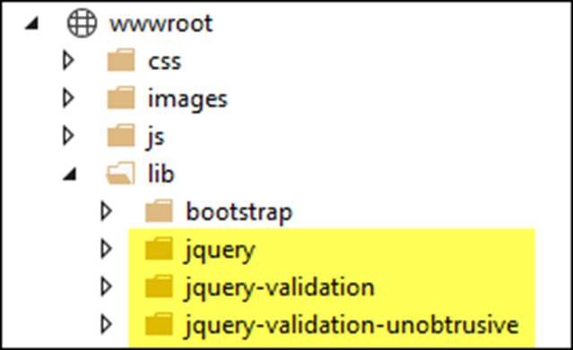
The jQuery libraries that download by default with the MVC template

Slide 28
The jQuery libraries in a Layout view
<head>
<meta name="viewport" content="width=device-width" />
<link href="~/lib/bootstrap/dist/css/bootstrap.min.css"
rel="stylesheet" />
<link href="~/css/site.css" rel="stylesheet" />
<script src="~/lib/jquery/dist/jquery.min.js"></script>
<script src="~/lib/jquery-validation/dist/
jquery.validate.min.js">
</script>
<script src="~/lib/jquery-validation-unobtrusive/
jquery.validate.unobtrusive.min.js">
</script>
<title>@ViewBag.Title</title>
</head>

Slide 29
Some caveats to client-side validation
It only works correctly with property-level validation, not model-level validation.
Any server-side validation doesn’t run until all client-side validation passes. This can lead to a 2-step process that may annoy some users.
Not all data annotations work properly on the client. In the example below, for instance, the Range annotation for the DOB field isn’t working as it should.

Slide 30
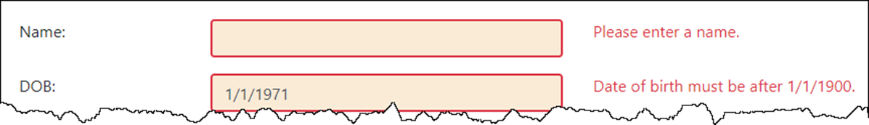
The form in the browser with client-side validation

Slide 31
Classes used to create a custom attribute
ValidationAttribute
ValidationContext
ValidationResult
A virtual method of the ValidationAttribute class
IsValid(object, context)
A constructor of the ValidationResult class
ValidationResult(string)
A field of the ValidationResult class
Success

Slide 32
A custom attribute that checks if a date is in the past
public class PastDateAttribute : ValidationAttribute
{
protected override ValidationResult IsValid(object value,
ValidationContext ctx)
{
if (value is DateTime) {
DateTime dateToCheck = (DateTime)value;
if (dateToCheck < DateTime.Today) {
return ValidationResult.Success;
}
}
string msg = base.ErrorMessage ??
$"{ctx.DisplayName} must be a valid past date.";
return new ValidationResult(msg);
}
}

Slide 33
Code that uses the PastDate attribute with the default validation message
[PastDate]
public DateTime? DOB { get; set; }
How it looks in the browser
Code that uses the PastDate attribute with a custom validation message
[PastDate(ErrorMessage =
"Please enter a date of birth in the past.")]
public DateTime? DOB { get; set; }

Slide 34
A custom attribute that accepts values (part 1)
public class YearsFromNowAttribute : ValidationAttribute
{
private int numYears;
public YearsFromNowAttribute(int years) {
numYears = years;
}
public bool IsPast { get; set; } = false;
protected override ValidationResult IsValid(object value,
ValidationContext ctx)
{
if (value is DateTime) {
// cast value to DateTime
DateTime dateToCheck = (DateTime)value;
// calculate date range
DateTime now = DateTime.Today;
DateTime from;
if (IsPast) {
from = new DateTime(now.Year, 1, 1);
from = from.AddYears(-numYears);
}

Slide 35
A custom attribute that accepts values (part 2)
else {
from = new DateTime(now.Year, 12, 31);
from = from.AddYears(numYears);
}
// check date
if (IsPast) {
if (dateToCheck >= from && dateToCheck < now) {
return ValidationResult.Success;
}
}
else {
if (dateToCheck > now && dateToCheck <= from) {
return ValidationResult.Success;
}
}
}
string msg = base.ErrorMessage ??
ctx.DisplayName + " must be a " + (IsPast ? "past" : "future") + " date within " +
numYears + " years of now.";
return new ValidationResult(msg);
}
}

Slide 36
A DOB property that requires a past date no more than 100 years ago
[YearsFromNow(100, IsPast = true)]
public DateTime? DOB { get; set; }

Slide 37
A custom attribute that checks more than one property in a class
public class RequiredContactInfoAttribute : ValidationAttribute
{
protected override ValidationResult IsValid(object v,
ValidationContext c){
var cust = (Customer)c.ObjectInstance;
if (string.IsNullOrEmpty(cust.PhoneNumber) &&
string.IsNullOrEmpty(cust.EmailAddress))
{
string msg = base.ErrorMessage ??
"Enter phone number or email.";
return new ValidationResult(msg);
}
else {
return ValidationResult.Success;
}
}
}

Slide 38
The method of the IValidatableObject interface
Validate(context)
A constructor of the ValidationResult class
ValidationResult(m, list)

Slide 39
A custom validation class that checks more than one field
public class Customer : IValidatableObject {
...
[Required(ErrorMessage = "Please enter a date of birth.")]
public DateTime? DOB { get; set; }
public string PhoneNumber { get; set; }
public string EmailAddress { get; set; }
public IEnumerable<ValidationResult> Validate(ValidationContext ctx) {
if (DOB > DateTime.Now)
{
yield return new ValidationResult(
"Date of birth can't be in the future.",
new[] { nameof(DOB) });
}
if (string.IsNullOrEmpty(PhoneNumber) &&
string.IsNullOrEmpty(EmailAddress))
{
yield return new ValidationResult(
"Please enter a phone number or email address.",
new[] { nameof(PhoneNumber), nameof(EmailAddress) });
}
}
}

Slide 40
A method of the IClientModelValidator interface
AddValidation(context)

Slide 41
The updated PastDate attribute with client-side validation (part 1)
using Microsoft.AspNetCore.Mvc.ModelBinding.Validation;
...
public class PastDateAttribute : ValidationAttribute, IClientModelValidator
{
private int numYears;
public PastDateAttribute(int years = -1) => numYears = years;
protected override ValidationResult IsValid(object val,
ValidationContext ctx)
{
if (val is DateTime) {
DateTime dateToCheck = (DateTime)val;
if (numYears == -1) { // no limit on past date
if (dateToCheck < DateTime.Today)
return ValidationResult.Success;
} else {
DateTime minDate = DateTime.Today.AddYears(-numYears);
if (dateToCheck >= minDate && dateToCheck < DateTime.Today)
return ValidationResult.Success;
}
}
return new ValidationResult(GetMsg(ctx.DisplayName));
}

Slide 42
The updated PastDate attribute (part 2)
public void AddValidation(ClientModelValidationContext c)
{
if (!c.Attributes.ContainsKey("data-val"))
c.Attributes.Add("data-val", "true");
c.Attributes.Add("data-val-pastdate-numyears", numYears.ToString());
c.Attributes.Add("data-val-pastdate",
GetMsg(c.ModelMetadata.DisplayName ?? c.ModelMetadata.Name));
}
private string GetMsg(string name) =>
base.ErrorMessage ?? name + " must be a valid past date" +
(numYears == -1 ? "." : " (max " + numYears + " years ago).");
}

Slide 43
A model property with the PastDate attribute
[PastDate(100)]
public DateTime? DOB { get; set; }
The HTML that the PastDate attribute emits
<input type="text" class="form-control" data-val="true"
data-val-pastdate=
"DOB must be a valid past date (max 100 years ago)."
data-val-pastdate-numyears="100" id="DOB" name="DOB" value="" />

Slide 44
The pastdate.js file (part 1)
jQuery.validator.addMethod("pastdate",
function (value, element, param) {
// get date entered by user, confirm it's a date
if (value === '') return false;
var dateToCheck = new Date(value);
if (dateToCheck === "Invalid Date") return false;
// get the number of years
var numYears = Number(param);
// get the current date
var now = new Date();

Slide 45
The pastdate.js file (part 2)
// check date
if (numYears == -1) {
if (dateToCheck < now) return true;
} else {
// calculate limit
var minDate = new Date();
var minYear = now.getFullYear() - numYears;
minDate.setFullYear(minYear);
if (dateToCheck >= minDate && dateToCheck < now)
return true;
}
return false;
});
jQuery.validator.unobtrusive.adapters.addSingleVal(
"pastdate", "numyears");

Slide 46
The header section of the layout
<head>
<meta name="viewport" content="width=device-width" />
<link href="~/lib/bootstrap/dist/css/bootstrap.min.css"
rel="stylesheet" />
<script src="~/lib/jquery/jquery.min.js"></script>
<script src="~/lib/jquery-validation/jquery.validate.min.js">
</script>
<script src="~/lib/jquery-validation-unobtrusive/
jquery.validate.unobtrusive.min.js"></script>
<script src="~/js/pastdate.js"></script>
<title>@ViewBag.Title</title>
</head>

Slide 47
Two constructors of the RemoteAttribute class
RemoteAttribute(act, ctl)
RemoteAttribute(act, ctl, area)
A model property with a Remote attribute
[Remote("CheckEmail", "Validation")]
public string Email { get; set; }
The CheckEmail() action method
public JsonResult CheckEmail(string email)
{
bool hasEmail = Utility.CheckEmail(email);
if (hasEmail)
return Json(
$"Email address {email} is already registered.");
else
return Json(true);
}

Slide 48
One property of the RemoteAttribute class
AdditionalFields
Remote validation that gets data from additional fields
The model
[Remote("CheckEmail", "Validation",
AdditionalFields = "Username, Region")]
public string Email { get; set; }
public string Username { get; set; }
The view
<input asp-for="EmailAddress" class="form-control" />
<input asp-for="Username" class="form-control" />
<input type="hidden" name="Region" value="West" />
The CheckEmail() action method
public JsonResult CheckEmail (string email, string username, string region){
// validation code
}

Slide 49
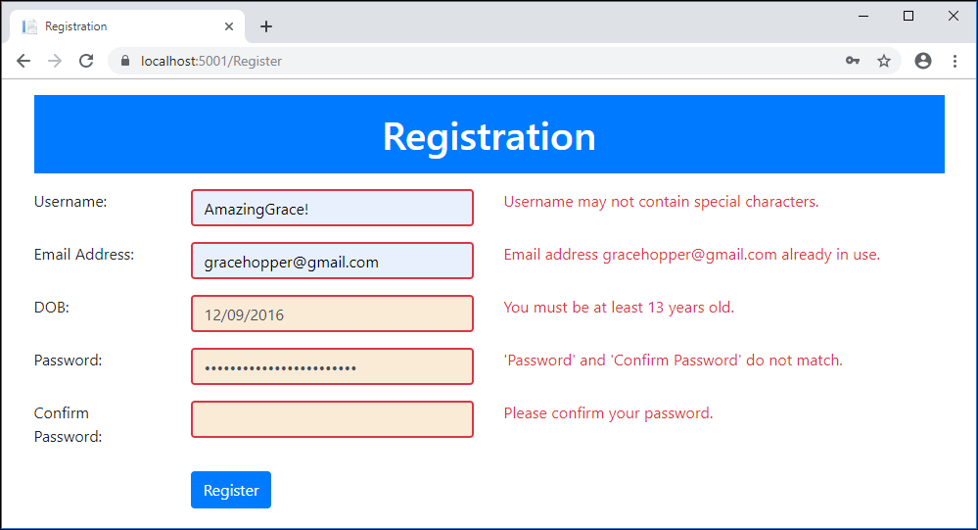
The Registration app with invalid data

Slide 50
The CSS for the validation class
.input-validation-error {
border: 2px solid #dc3545; /* text-danger */
background-color: #faebd7; /* antique white */
}

Slide 51
The Customer class (part 1)
using System.ComponentModel.DataAnnotations;
using System.ComponentModel.DataAnnotations.Schema;
using Microsoft.AspNetCore.Mvc;
...
public class Customer
{
public int ID { get; set; } // automatically generated
[Required(ErrorMessage = "Please enter a username.")]
[RegularExpression("^[a-zA-Z0-9 ]+$", ErrorMessage =
"Username may not contain special characters.")]
public string Username { get; set; }
[Required(ErrorMessage = "Please enter an email address.")]
[Remote("CheckEmail", "Validation")]
public string EmailAddress { get; set; }
[Required(ErrorMessage = "Please enter a date of birth.")]
[MinimumAge(13, ErrorMessage =
"You must be at least 13 years old.")]
public DateTime? DOB { get; set; }

Slide 52
The Customer class (part 2)
[Required(ErrorMessage = "Please enter a password.")]
[Compare("ConfirmPassword")]
[StringLength(25, ErrorMessage =
"Please limit your password to 25 characters.")]
public string Password { get; set; }
[Required(ErrorMessage = "Please confirm your password.")]
[Display(Name = "Confirm Password")]
[NotMapped]
public string ConfirmPassword { get; set; }
}

Slide 53
The RegistrationContext class
public class RegistrationContext : DbContext
{
public RegistrationContext(
DbContextOptions<RegistrationContext> options)
: base(options) { }
public DbSet<Customer> Customers { get; set; }
}

Slide 54
The MinimumAgeAttribute class (part 1)
using System.ComponentModel.DataAnnotations;
using Microsoft.AspNetCore.Mvc.ModelBinding.Validation;
...
public class MinimumAgeAttribute : ValidationAttribute, IClientModelValidator
{
private int minYears;
public MinimumAgeAttribute(int years) {
minYears = years;
}
// overrides IsValid() method of ValidationAttribute base class
protected override ValidationResult IsValid(object value,
ValidationContext ctx) {
if (value is DateTime) {
DateTime dateToCheck = (DateTime)value;
dateToCheck = dateToCheck.AddYears(minYears);
if (dateToCheck <= DateTime.Today) {
return ValidationResult.Success;
}
}
return new ValidationResult(GetMsg(ctx.DisplayName));
}

Slide 55
The MinimumAgeAttribute class (part 2)
// implements AddValidation() method of IClientModelValidator
// interface
public void AddValidation(ClientModelValidationContext ctx) {
if (!ctx.Attributes.ContainsKey("data-val"))
ctx.Attributes.Add("data-val", "true");
ctx.Attributes.Add("data-val-minimumage-years",
minYears.ToString());
ctx.Attributes.Add("data-val-minimumage",
GetMsg(ctx.ModelMetadata.DisplayName ??
ctx.ModelMetadata.Name));
}
private string GetMsg(string name) =>
base.ErrorMessage ??
$"{name} must be at least {minYears} years ago.";
}

Slide 56
The minumim-age JavaScript file
jQuery.validator.addMethod("minimumage",
function(value, element, param) {
if (value === '') return false;
var dateToCheck = new Date(value);
if (dateToCheck === "Invalid Date") return false;
var minYears = Number(param);
dateToCheck.setFullYear(dateToCheck.getFullYear() +
minYears);
var today = new Date();
return (dateToCheck <= today);
});
jQuery.validator.unobtrusive.adapters.addSingleVal(
"minimumage", "years");

Slide 57
The Validation controller
public class ValidationController : Controller
{
private RegistrationContext context;
public RegisterController(RegistrationContext ctx) =>
context = ctx;
public JsonResult CheckEmail(string emailAddress)
{
string msg = Check.EmailExists(context,
emailAddress);
if (string.IsNullOrEmpty(msg)) {
TempData["okEmail"] = true;
return Json(true);
}
else return Json(msg);
}
}

Slide 58
The Register controller (part 1)
public class RegisterController : Controller
{
private RegistrationContext context;
public RegisterController(RegistrationContext ctx) =>
context = ctx;
public IActionResult Index() => View();
[HttpPost]
public IActionResult Index(Customer customer)
{
if (TempData["okEmail"] == null) {
string msg = Check.EmailExists(
context, customer.EmailAddress);
if (!String.IsNullOrEmpty(msg)) {
ModelState.AddModelError(
nameof(Customer.EmailAddress), msg);
}
}

Slide 59
The Register controller (part 2)
if (ModelState.IsValid) {
context.Customers.Add(customer);
context.SaveChanges();
return RedirectToAction("Welcome");
}
else return View(customer);
}
}

Slide 60
The static Check class
public static class Check
{
public static string EmailExists(RegistrationContext ctx,
string email) {
string msg = "";
if (!string.IsNullOrEmpty(email)) {
var customer = ctx.Customers.FirstOrDefault(
c => c.EmailAddress.ToLower() == email.ToLower());
if (customer != null)
msg = $"Email address {email} already in use.";
}
return msg;
}
}

Slide 61
The layout
<!DOCTYPE html>
<html>
<head>
<meta name="viewport" content="width=device-width" />
<title>@ViewBag.Title</title>
<link rel="stylesheet" type="text/css"
href="~/lib/bootstrap/dist/css/bootstrap.min.css">
<link href="~/css/site.css" rel="stylesheet" />
</head>
<body>
<div class="container">
<header class="bg-primary text-white text-center">
<h1 class="m-3 p-3">Registration</h1>
</header>
<main>
@RenderBody()
</main>
</div>
<script src="~/lib/jquery/dist/jquery.min.js"></script>
@RenderSection("scripts", false)
</body>
</html>

Slide 62
The Register/Index view (part 1)
@model Customer
@{
ViewData["Title"] = "Registration";
}
@section scripts {
<script src="~/lib/jquery-validation/dist/jquery.validate.min.js"></script>
<script src="~/lib/jquery-validation-unobtrusive/
jquery.validate.unobtrusive.min.js"></script>
<script src="~/js/minimum-age.js"></script>
}
<form asp-action="Index" method="post">
<div class="form-group row">
<div class="col-sm-2"><label>Username:</label></div>
<div class="col-sm-4">
<input asp-for="Username" class="form-control" /></div>
<div class="col">
<span asp-validation-for="Username"
class="text-danger"></span></div></div>

Slide 63
The Register/Index view (part 2)
<div class="form-group row">
<div class="col-sm-2"><label>Email Address:</label></div>
<div class="col-sm-4">
<input asp-for="EmailAddress" class="form-control" />
</div>
<div class="col">
<span asp-validation-for="EmailAddress"
class="text-danger"></span></div></div>
<div class="form-group row">
<div class="col-sm-2"><label>DOB:</label></div>
<div class="col-sm-4">
<input type="text" asp-for="DOB"
class="form-control" /></div>
<div class="col">
<span asp-validation-for="DOB"
class="text-danger"></span></div></div>
<!-- Password and ConfirmPassword fields -->
<div class="row">
<div class="offset-2 col-sm-4">
<button type="submit" class="btn btn-primary">
Register</button>
</div></div>
</form>

